Slide 1

FACTORS INFLUENCING LOAN DEFAULTS
Meritrust Credit Union

Slide 2



AGENDA
Sudhanshu Sekhar Dash
Team Lead / Business Analyst
sxdash@shockers.wichita.edu
Project Overview
Data Assessment
Methodology
Results
Conclusion
Uma Pammi
Data Analytics Engineer
uxpammi@shockers.wichita.edu
Sri Revanth Kandepi
Data Quality Analyst
kxsrirevanth@shockers.wichita.edu
Notes:
#Uma Pammi

Slide 3
PROJECT OVERVIEW
BUSINESS USE CASE, PROJECT PROCESS

Slide 4



BUSINESS USE CASE
Opportunity: Analyze historical lending data to predict which loans will charge off and associated risk factors.
Value: Charge offs negatively impact the organization's financial health, reputation, and market value, thereby presenting challenges to profitability and sustainable growth.
Success: Identify key factors linked to potential defaults so actions can be taken to mitigate risk.
Notes:
#Sudhanshu Sekhar Dash
Understanding past lending trends is vital to predict potential financial setbacks, allowing us to take preventive measures, safeguarding our financial health and reputation.

Slide 5
PROJECT PROCESS
Business Use Case Overview
Data Quality Assessment
Data Transformation and Cleaning
Data Modeling
Deliverable Development
Final Delivery
Post-wrap with Dr. Sue

Slide 6
STEPS PERFORMED
Analyzed the impact of various data points on loan defaults.
Visualized and understood the data's main features.
Data Preparation: Addressed missing values, removed unwanted features, and handled outliers.
Used logistic regression and random forest models to learn from the data.
Tested our models and measured how well they performed using several scores.
Notes:
#Revanth Kandepi
Explored data thoroughly by looking at key aspects and ensured it's ready for analysis. Used specific models to predict outcomes, rigorously tested them to see how well they worked using different measures.

Slide 7
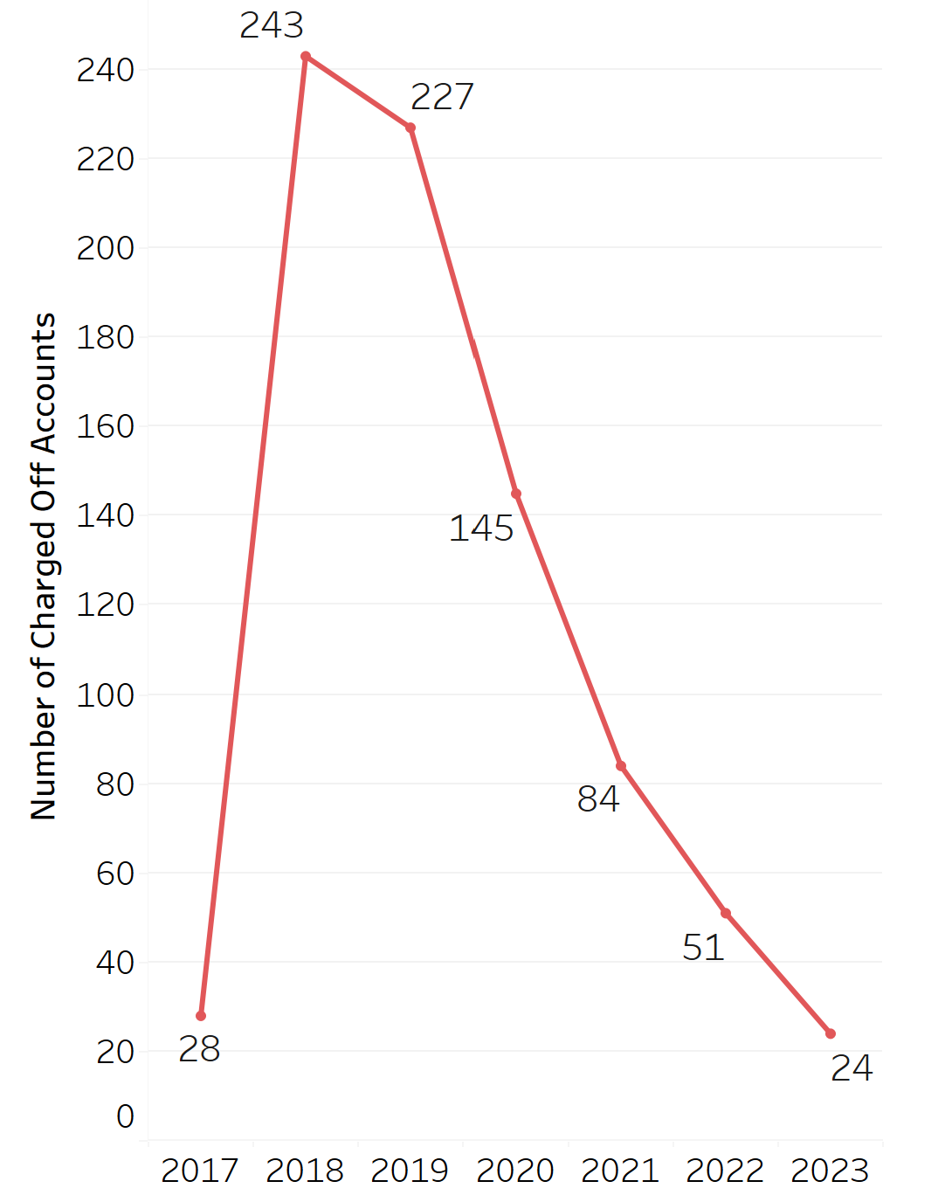
DATA OVERVIEW
The dataset contains data for loans issued in the year 2017.
Loan charge-off dates span the period from 2017 to 2023.
Number of rows in the dataset: 15,482
Number of features (columns) in the dataset: 33
Notes:
#Uma Pammi
We have a comprehensive dataset covering loans issued in 2017, with charge-off information spanning from 2017 to 2023. There are 15,482 records and 33 different features, providing a rich source for our analysis.

Slide 8
DATA QUALITY

Slide 9
DATA QUALITY OVERVIEW
Duplicates: No duplicate rows were found.
Missing values:
Charge Off Balance Amount: 94.82% - Column dropped
Charge Off Date: 94.82% - Column dropped
Loan to Value(OLTV): 18.41% -Imputed missing with 0s, existing with 1s.
Credit Score : 5.39% - Rows dropped
Credit Tier : 5.39% - Rows dropped
Distribution: The distribution of values in the priority columns was favorable.
Outliers: Minimal instances of outliers were observed in the Debt-to-Income Ratio (DEBT).
Notes:
#Sudhanshu Sekhar Dash
We ensured data integrity by addressing missing values, dropping unnecessary columns with high missing percentages, and handling outliers. No duplicate rows were present, and the remaining data showed a favorable distribution, laying a solid foundation for our analysis.

Slide 10
DATA CLEANING: FEATURE REDUCTION
Excluded Features | Reason
Charge Off Balance, Charge Off Date | Higher missing values.
Account Number | Identifier and doesn't impact loan charge-off.
Closed Date(Maturity Date) | No impact on charge-off.
Variables indicating customer checking, savings, or CD with the credit union | No dataset correlation.
Total Deposits | No dataset correlation.
Unsecured debt to the borrower's income(UDTI) | High correlation with priority variables.
Notes:
#Revanth Kandepi
We streamlined our dataset by excluding features with high missing values, those unrelated to loan charge-offs, and variables showing no correlation. This focused approach ensures a more relevant and impactful analysis.

Slide 11
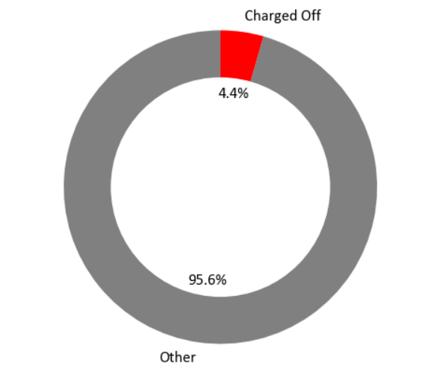
MAIN KPI
Account Status Distribution
Problem Statement: To identify and mitigate loan defaults using historical lending data analysis.
Main KPI: “Account Status".
The default rate is a critical KPI in financial analysis as it directly reflects the risk associated with the loan portfolio.
The 'Charged Off (CO)' status is a vital metric that reflects account performance in our dataset.
0- Not Charged Off; 1- Charged Off
Notes:
#Sudhanshu Sekhar Dash
Our primary goal is to address and minimize loan defaults by analyzing historical lending data. The "Account Status" serves as a key performance indicator, specifically the 'Charged Off (CO)' status, indicating loans at risk. Understanding this metric is crucial for assessing and managing the associated risk in our loan portfolio.

Slide 12
PROJECT SCOPE: INFLUENCERS
Credit Score: Lower credit scores are often associated with higher default rates.
Debt-to-Income Ratio: A high ratio suggests that a significant portion of the borrower's income is committed to debt payments.
Loan Type: Loans obtained indirectly through dealerships, or third parties may have different default patterns compared to loans obtained directly.
Interest Rate: Higher interest rates may increase the likelihood of defaults.
Loan Amount: It can increase the risk of default if the borrower's financial capacity and creditworthiness are not aligned with the size of the loan.
Notes:
#Uma Pammi
Analyzing our data reveals key factors influencing loan defaults: lower credit scores, high debt-to-income ratios, and loan types obtained indirectly pose higher risks. Additionally, higher interest rates and mismatched loan amounts with borrowers' financial capacity increase default likelihood. Understanding these elements is crucial for effective risk management.

Slide 13
EXPLORATION AND FEATURE ENGINEERING

Slide 14
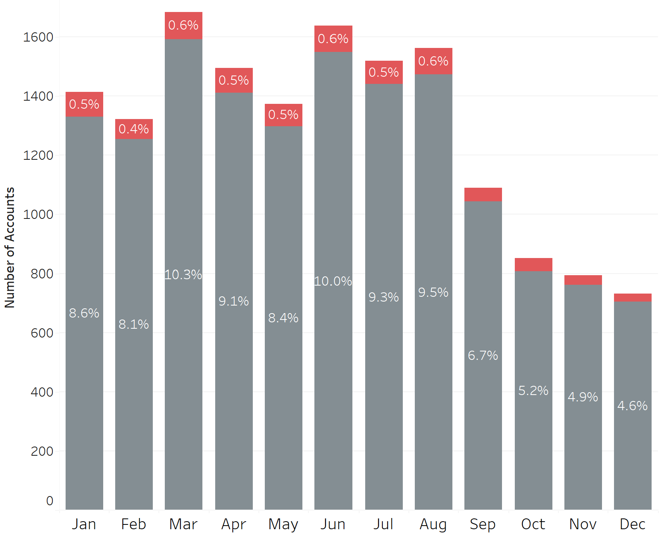
Seasonality
Utilized features from 'Fund Issued Date' to understand the seasonality of total loan issuance and charged-off loans.
Majority of loans were issued in March, with fewer issuances observed in December. Charged-off cases followed a similar pattern.
0.3%
0.3%
0.2%
0.2%
Notes:
#Uma Pammi
Leveraging data from the 'Fund Issued Date,' we uncovered seasonal patterns in loan issuance and defaults. Notably, March saw a peak in loan issuances, aligning with a corresponding pattern in charged-off cases, offering insights into the seasonality of loan defaults.

Slide 15
FEATURE ENGINEERING
Credit Score
Loan Amount
Loan Type
Notes:
#Revanth Kandepi

Slide 16
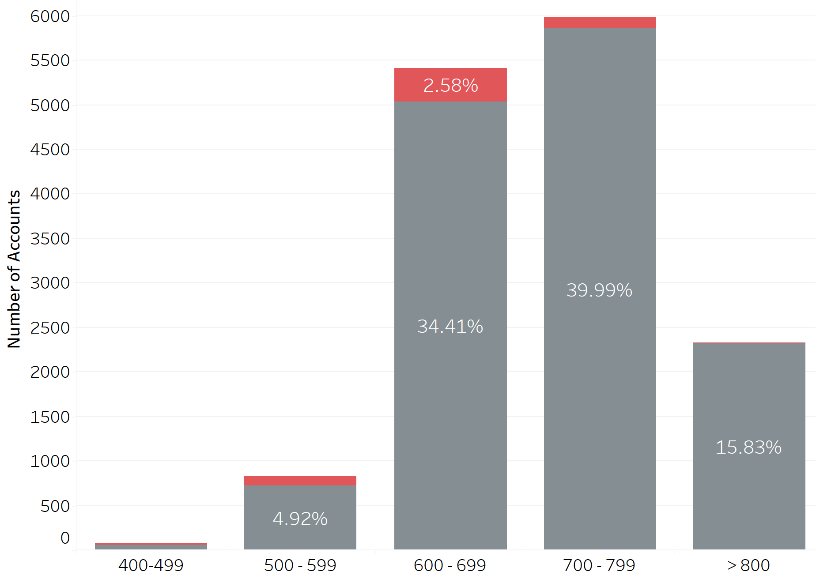
CREDIT SCORE
0.87%
Grouped the credit score to identify the credit score interval with higher loan charge-off rates.
Majority of charged-off loans fall within the interval of 600-699.
0.07%
0.79%
0.12%
Notes:
#Revanth Kandepi
Enhanced understanding of credit score impact by grouping intervals. Loans with credit scores between 600-699 exhibit higher charge-off rates, emphasizing the significance of this range in predicting defaults.

Slide 17
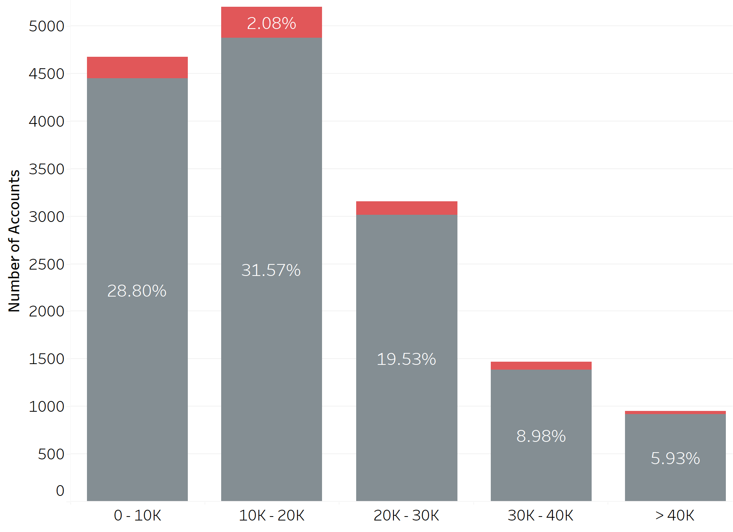
LOAN AMOUNT
Partitioned 'Original Balance Amount' for easier charged-off loan identification by range.
50% of the total loans issued are concentrated within the 20k range, indicating a significant proportion in this specific interval.
1.47%
0.80%
0.52%
0.25%
Notes:
#Sudhanshu Sekhar Dash
Simplified charged-off loan identification by categorizing 'Original Balance Amount'. Notably, 50% of loans fall within the 20k range, highlighting the concentration of loans in this specific interval for focused analysis.

Slide 18
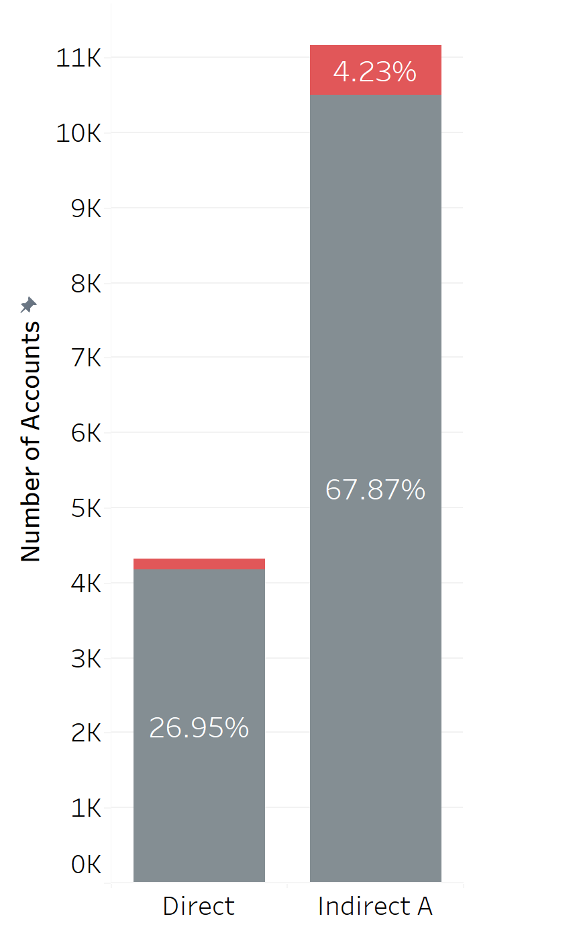
LOAN TYPE
Divided into distinct categories to assess which loan type exhibits the highest charge-off rate.
Indirect loans issued by third parties outnumber direct loans, and the charged-off pattern aligns accordingly.
0.95%
Notes:
#Uma Pammi
Categorized 'Loan Type' to evaluate charge-off rates, revealing that indirect loans from third parties outnumber direct loans. The charged-off pattern aligns accordingly, providing insights for risk assessment.

Slide 19
METHODOLOGY AND ANALYSIS

Slide 20
METHODOLOGY
Logistic Regression
What It Does: Helps us understand the factors that influence outcomes, such as whether the loan is charged off or not.
Why We Used It: Simple yet effective way to predict binary results, like a yes/no or true/false situation.
Random Forest Classifier
What It Does: It's a team of decision-makers, each giving their opinion, and then a final decision is made based on the majority vote.
Why We Used It: It's powerful, handles varied data well, and avoids common mistakes, making our predictions more reliable.
Notes:
#Revanth
Our methodology involves utilizing Logistic Regression for straightforward insight into factors affecting loan charge-off, thanks to its simplicity in predicting binary outcomes. The Random Forest Classifier complements this approach by employing a team of decision-makers, ensuring robust predictions through collective wisdom and data adaptability.

Slide 21
LOGISTIC REGRESSION
Feature | Class | Odds Ratio | Insights
Credit Score | 500-599 | 0.021*** | Higher credit scores significantly decrease the odds of loan default, highlighting the pivotal role of good credit in risk mitigation.
 | 600-699 | 0.016***
 | 700-799 | 0.001***
 | 800-900 | 0.000***
Loan Amount | 10k-20k | 1.474*** | Higher loan amounts are associated with increased odds of default, emphasizing the importance of managing risk in larger loan transactions.
 | 20k-30k | 1.964***
 | 30-40k | 2.607***
 | 40k+ | 3.282***
Debt to Income Ratio | 10-20 | 0.025*** | A lower debt-to-income ratio significantly reduces the odds of loan default.
 | 20-30 | 0.037***
 | 30+ | 0.072***
Interest Rate | Moderate | 0.302*** | Higher interest rates are linked to higher odds of default, suggesting that low interest serves as a protective factor against loan default.
 | High | 0.770***
Loan Type | Indirect | 1.286*** | Indicates an increased likelihood of default compared to other loan types.
Notes:
#Sudhanshu
In understanding the odds ratios, we observe that higher credit scores significantly reduce the likelihood of loan default, emphasizing the importance of maintaining good credit. Additionally, larger loan amounts correlate with increased default odds, highlighting the need for careful risk management in substantial transactions.

Slide 22
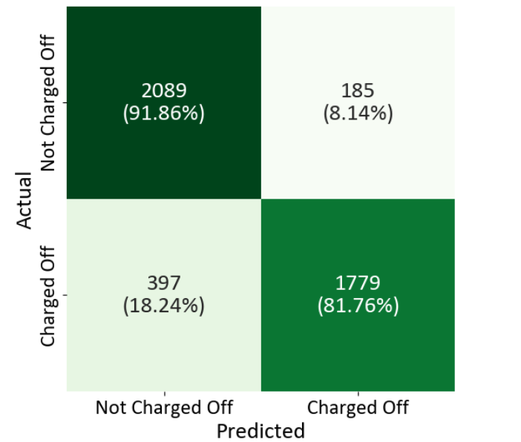
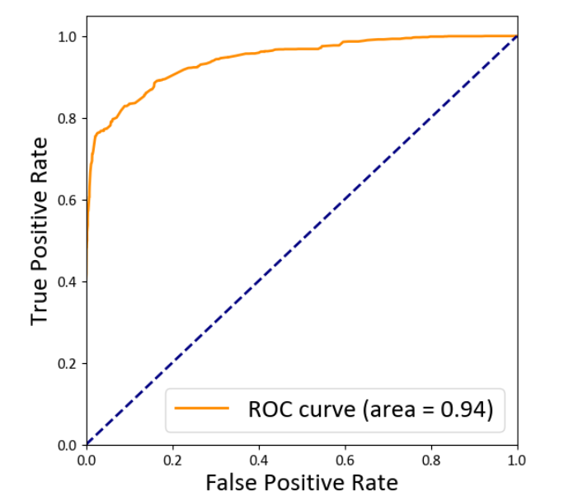
LOGISTIC REGRESSION
Accurate Non-Default Predictions:
The model correctly predicted "Not Charged Off" in 91.86% of cases.
Effective Default Detection:
It successfully identified "Charged Off" cases with an 81.76% accuracy rate.
Precision Enhancement Opportunity:
There's room for improving precision, as 8.14% of predictions were false positives.
Reducing False Negatives:
18.24% were misclassified as "Not Charged Off," suggesting further optimization potential.
Area Under the ROC Curve (AUC):
An AUC score of 0.94 indicates the model's strong ability to accurately distinguish between 'Charged Off' and 'Not Charged Off' cases.
Notes:
#Sudhanshu
The model accurately predicted loans not charged off in 84.43% of cases and effectively identified charged-off cases with an 81.43% accuracy rate. There's room for improving precision, as 15.57% of predictions were false positives, and further optimization can reduce false negatives, which were only 18.57%.

Slide 23
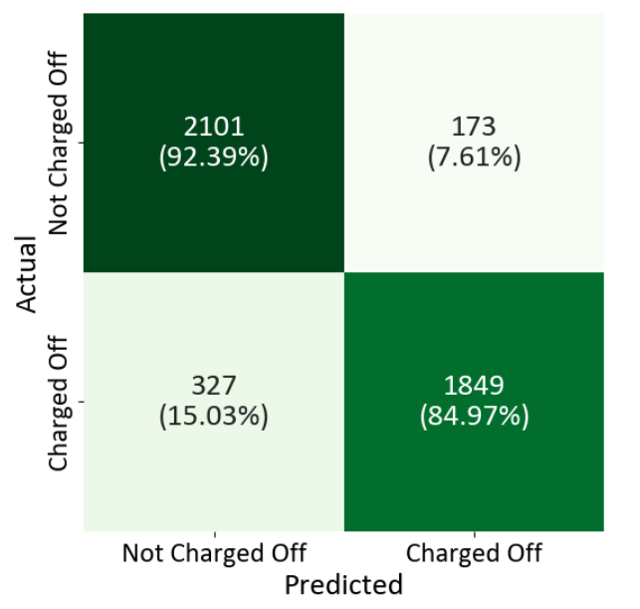
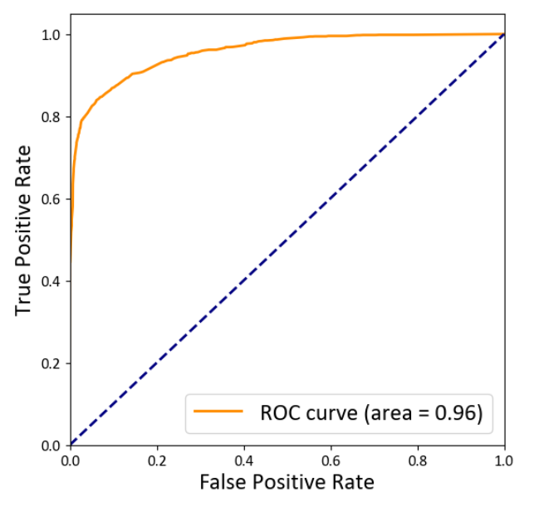
RANDOM FOREST
Accurate Non-Default Predictions:
The model correctly predicted "Not Charged Off" in 92.39% of cases.
Effective Default Detection:
It successfully identified "Charged Off" cases with an 84.97% accuracy rate.
Precision Enhancement Opportunity:
There's room for improving precision, as 7.61% of predictions were false positives.
Reducing False Negatives:
15.03% were misclassified as "Not Charged Off," suggesting further optimization potential.
Area Under the ROC Curve (AUC):
An AUC score of 0.96 indicates the model's strong ability to accurately distinguish between 'Charged Off' and 'Not Charged Off' cases.
Notes:
#Sudhanshu
The model accurately predicted loans not charged off in 84.43% of cases and effectively identified charged-off cases with an 81.43% accuracy rate. There's room for improving precision, as 15.57% of predictions were false positives, and further optimization can reduce false negatives, which were only 18.57%.

Slide 24
RESULTS
Based on our analysis, the provided scores indicate that the Random Forests Classifier performed better than the Logistic Regression model in terms of accuracy on both the training and test datasets.
Model | Train Accuracy | Test Accuracy
Logistic Regression | 87.2 | 86.9
Random Forests Classifier | 88.9 | 88.7
Evaluation Metrics | Logistic Regression | Random Forests Classifier
F1 Score | 0.86 | 0.88
Precision | 0.91 | 0.91
Recall | 0.82 | 0.85
Error | 0.13 | 0.11
Notes:
#Sudhanshu
Our analysis indicates that the Random Forests Classifier outperformed the Logistic Regression model with higher accuracy on both training and test datasets. Additionally, key evaluation metrics such as F1 Score, Precision, Recall, and Error rates support the superior performance of the Random Forests Classifier in predicting loan defaults.

Slide 25
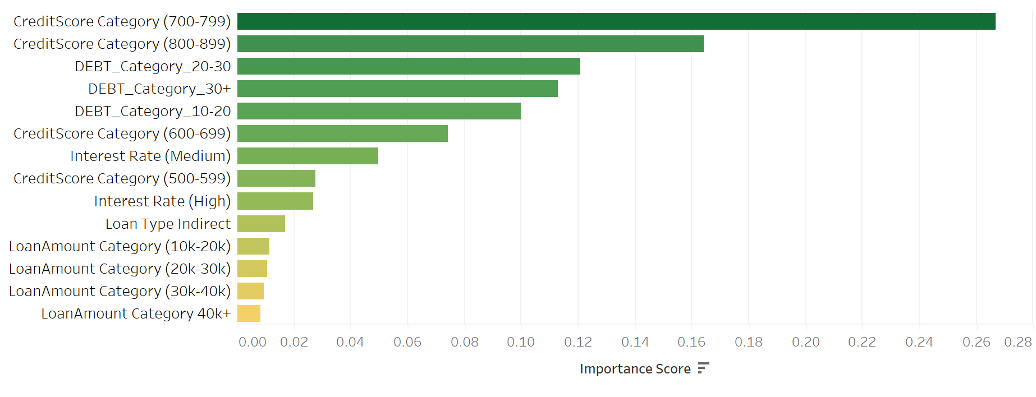
FEATURE IMPORTANCE
Credit scores, interest rates, loan types, and debt categories intricately shape the model's predictions, unveiling a comprehensive view of influential factors in the outcome.
Notes:
#Uma
Our model emphasizes the impact of credit scores, interest rates, loan types, and debt categories, offering a holistic understanding of the key factors influencing loan outcomes.

Slide 26
INTERPRETATIONS
Monitoring Historical Loans:
The model can be leveraged to retrospectively analyze loans granted from 2018 to the present, providing insights into the historical performance of loans and enabling the forecast of potential defaults in 2025.
Scenario Analysis:
The model can be used for scenario analysis by updating input features such as recession and economic growth, enabling the simulation of the impact of various economic conditions on the loan portfolio.
Notes:
#Uma
Utilizing the model for retrospective analysis enables a comprehensive understanding of the historical loan performance, facilitating insights and predictions for potential defaults in 2024. Moreover, the model's flexibility allows for scenario analysis, enabling simulations to assess the impact of different economic conditions on the loan portfolio.

Slide 27
PREVIEW
Account No. | Credit Score | Loan Type | Loan Amount | Inflation | Prediction
1 | 540 | Indirect A | 17452 | 5.4 | Risk
2 | 732 | Indirect A | 27986 | 5.4 | Safe
3 | 690 | Direct | 12563 | 5.4 | Safe
4 | 614 | Indirect A | 31254 | 5.4 | Risk
5 | 812 | Direct | 7450 | 5.4 | Safe
*assuming inflation rate for year 2024-25 as 5.4%

Slide 28
USE CASES
Credit Risk Assessment: A financial institution can employ this model to assess credit risk, enhancing the precision of identifying high-risk applicants and minimizing the likelihood of non-performing loans.
Automated Loan Approval System: An online lending platform can use this to automate loan approval decisions, flagging applications with a high likelihood of default and streamlining the lending process.
Notes:
#Revanth
This model is instrumental for financial institutions in conducting more accurate credit risk assessments, enabling the identification of high-risk applicants and reducing the chances of non-performing loans. Furthermore, an online lending platform can integrate this model to automate loan approval decisions, efficiently flagging applications with a higher likelihood of default and optimizing the lending process.

Slide 29
THANK YOU!

